Slide 1
What Makes the World Happy?
Data Analysis of Happiness Scores
Presented by Lisa Cannon, Monica Ramos, Xuancong Tran

Slide 2
Motivation and Summary
Levels of happiness varies throughout the world. There are likely many factors that influence the level of happiness in a country. We seek to determine some factors that could be used to predict happiness.
This study seeks to determine:
How is happiness distributed around the world?
What are some of the factors influence happiness?
While we are able to determine several factors that are predictive of happiness, there are many other factors that are not considered and are beyond the scope of this study.

Slide 3
Questions
Happiness Distribution
How is happiness distributed around the world?
Does happiness vary by continent?
Are nearby countries similar in happiness levels?
How has happiness changed over time?
Do any of the following factors influence happiness?
GDP/PPP
Population Total/Population Density
Median Age
Level of Education
Alcohol Consumption
Internet Access
Disaster Risk
Amount of Sleep

Slide 4
Data Sources
Happiness data is obtained from The World Happiness Report
The report contains happiness scores and rankings data from the Gallup World Poll.
The poll asks respondents to think of a ladder with the best possible life for them being a 10 and the worst possible life being a 0 and to rate their own current lives on that scale.
Data is summarized at the country level
The World Happiness Report has rankings and scores for 2015-2018.
Contains data for 157 countries (there are 195 total)

Slide 5
Data Sources
Other sources of data are:
The World Health Organization
World Bank
World by Map
Human Development Reports, United Nations Development Programme
Wikipedia
Statista
Maps are from Google Maps

Slide 6
Data Cleaning
In order to compare happiness scores to information on other factors from the same year, we focused most of our analysis on happiness scores in 2016.
Our interest is only in merging to the countries present in the World Happiness Report.
Because data is pulled from multiple sources it is important to ensure that the merge key, country name, is consistent.
Each data source was missing information on a few countries. For this reason, individual variable analyses varies in number of countries included. (Ranging from to 125-155 countries)
Note: The source of sleeping includes information for only about 30 countries.

Slide 7
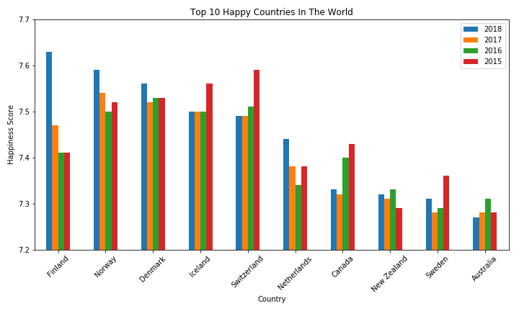
Happy Score Over time

Slide 8
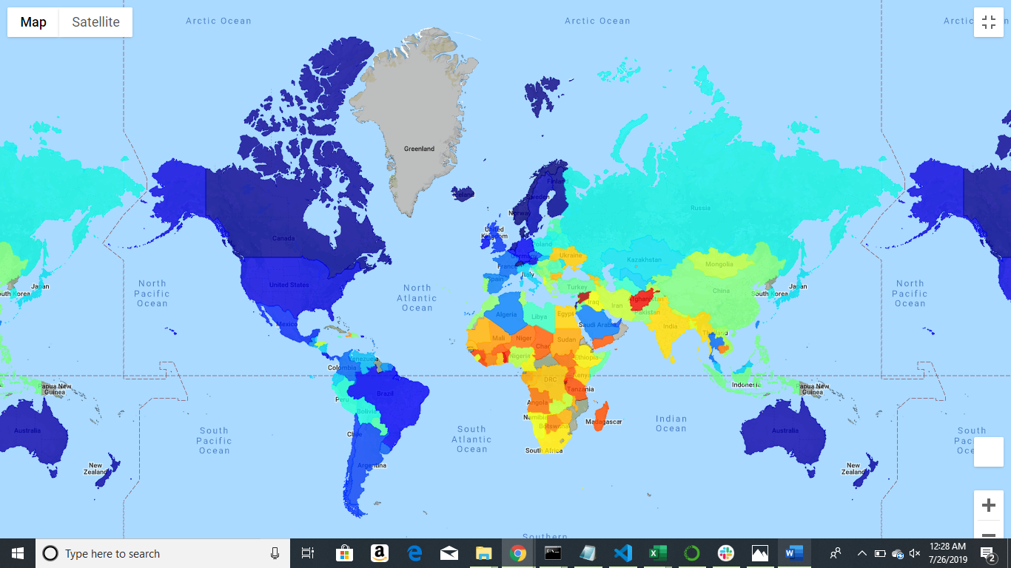
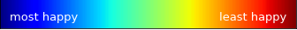
Happiness Score by Country

Slide 9
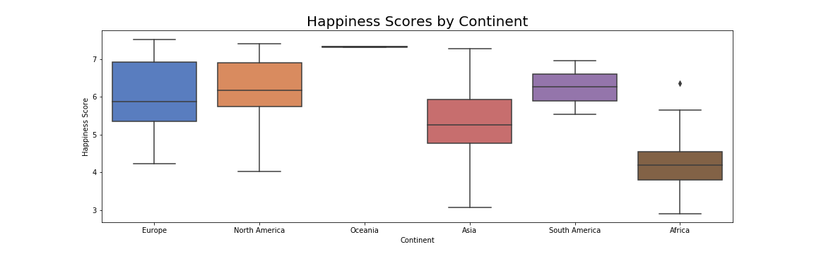
Happiness Distribution by Continent

Slide 10
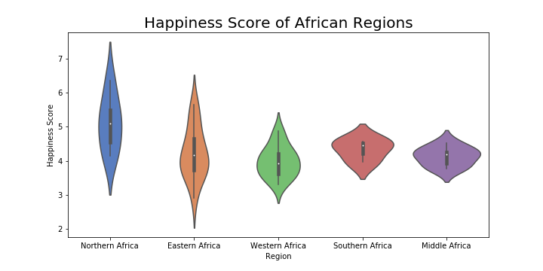
Happy Score for Regions in Africa
The average score and the range are significantly different between regions

Slide 11
T-test Comparison of Continents
Continent1 | Continent2 | T-stat | P-Value
Asia | Africa | 5.91587 | 0.00000
Asia | Europe | -4.03539 | 0.00012
Asia | North America | -3.14721 | 0.00453
Asia | South America | -5.14424 | 0.00001
Asia | Oceania | -15.41227 | 0.00000
Africa | Europe | -9.89033 | 0.00000
Africa | North America | -7.06010 | 0.00000
Africa | South America | -11.50633 | 0.00000
Africa | Oceania | -29.02330 | 0.00000
Europe | North America | -0.23084 | 0.81930
Europe | South America | -0.84738 | 0.40247
Europe | Oceania | -8.28201 | 0.00000
North America | South America | -0.37821 | 0.70903
North America | Oceania | -4.82574 | 0.00027
South America | Oceania | -7.82979 | 0.00001

Slide 12
Distance Analysis

Slide 13
Variable Analysis Is there a relationship between Happiness and GDP, PPP,etc

Slide 14
Variable Analysis Is there a relationship between Happiness and Median Age

Slide 15
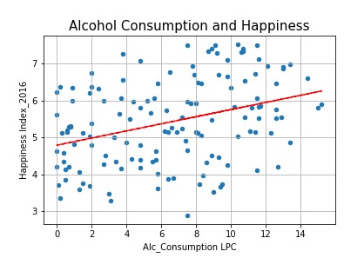
Variable Analysis Is there a relationship between Happiness and Alcohol Consumption
Surprisingly, alcohol consumption has a positive correlation with happiness Index. Alcohol consumption has always been linked to be used to numb pain and despair. Also, linked to crime, violence, accidents and death.
However, in this graph we can see that residents of happy countries probably consume alcohol for reasons like pleasure, indulgence and celebration.
r value: 0.3518

Slide 16
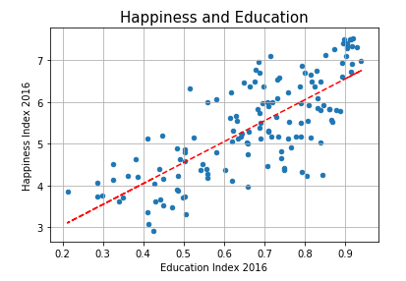
Variable Analysis Is there a relationship between Happiness and Education Index
This analysis shows that happier nations have a higher Education index than unhappy ones with a strong correlation of 0.76.
We can assume that Education is linked to sense of individual empowerment, community contribution and better job conditions.
All of it contributing to country’s residents sense of security and well being.
r value: 0.7603

Slide 17
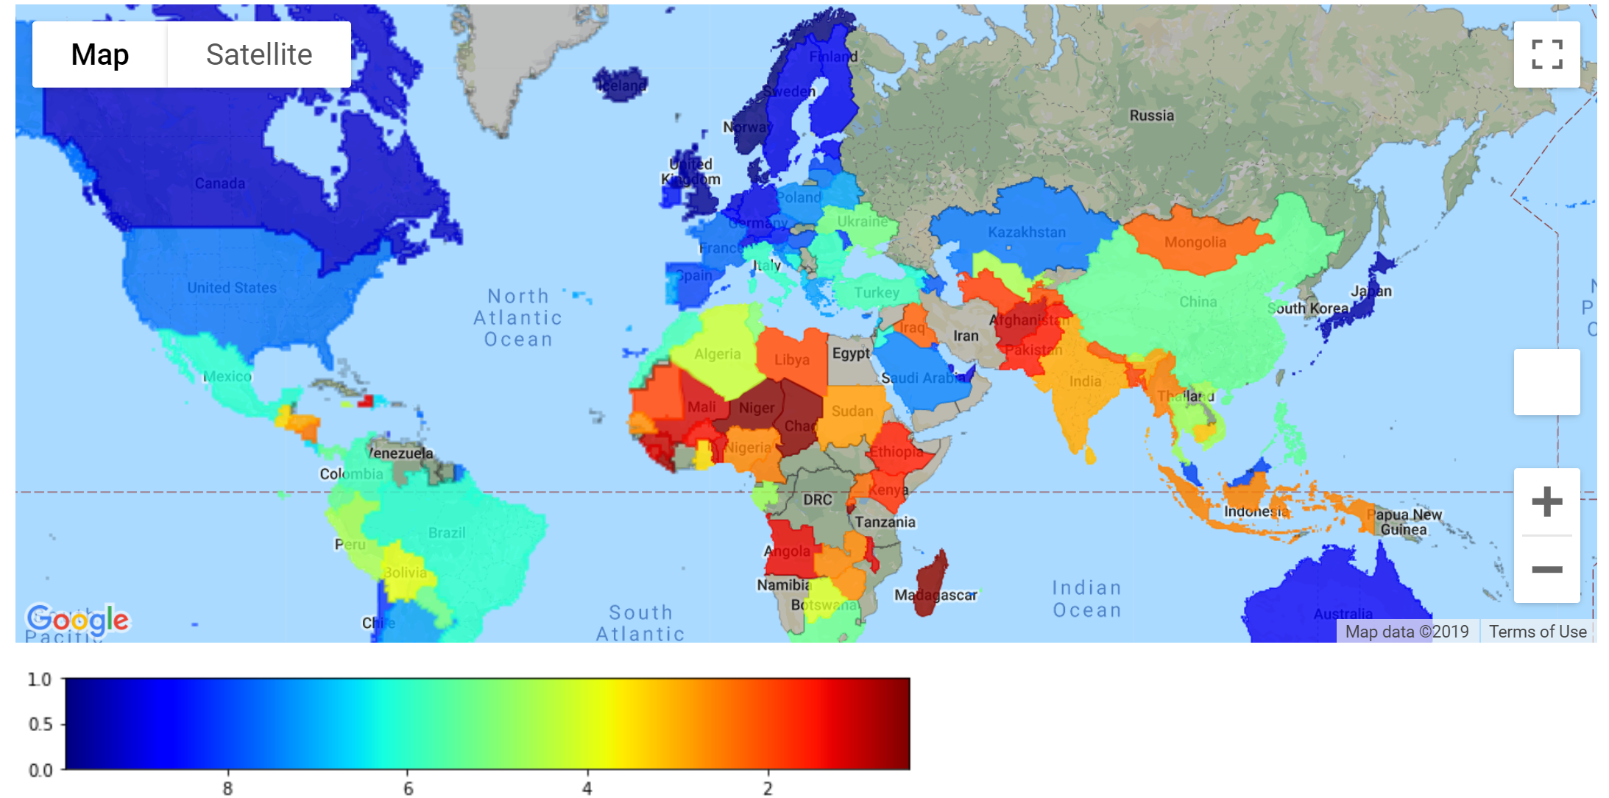
Internet access level throughout the world

Slide 18
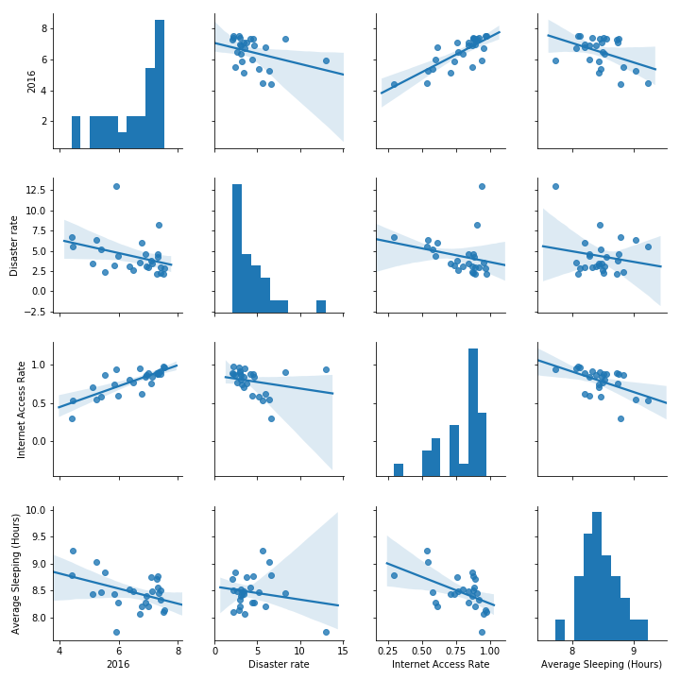
Variable Analysis Correlation between happiness score and disaster rate, internet access rate and sleeping.

Slide 19
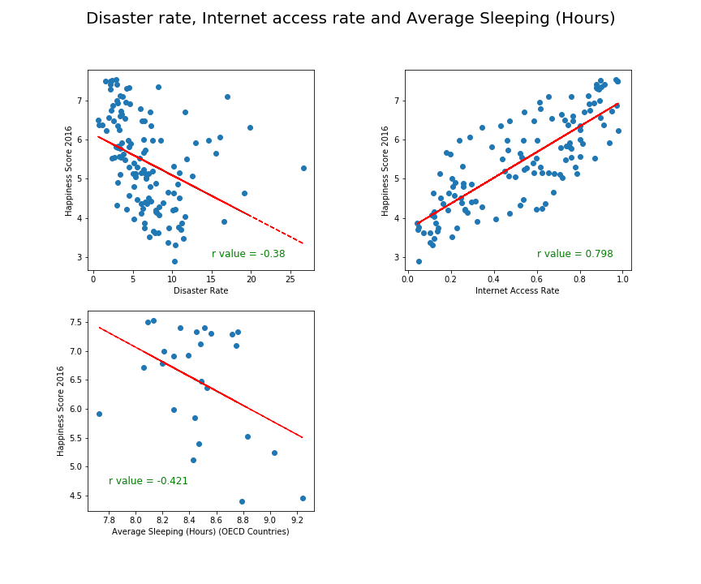
Variable Analysis Is there a relationship between Happiness and Disaster Risk, Internet access rate and Average Sleeping

Slide 20
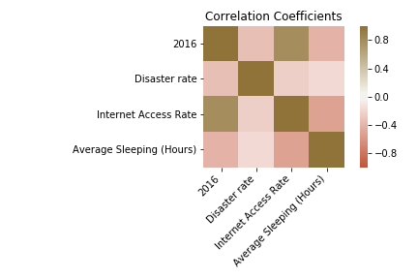
Variable Analysis Correlation Coefficients between happiness and disaster rate, internet access rate and average sleeping.

Slide 21
Discussion
We can conclude that higher Happiness Index around the world is concentrated in Europe, The Americas and Oceania, leaving Africa and Asia with the lower scores.
Finland, Norway, Denmark, Iceland and Switzerland are the countries with the higher Happiness Index score in the world. And they have consistently ranked at this level for 2015 to 2018.
Factors with high correlation to country happiness index:
GDP, Education Level, Access to Internet, ??????
Factors with some correlation to country happiness index:
Median age, Alcohol Consumption, Disaster Risk rate and Average Hours of Sleep
Factors with negative correlation to country happiness index:
?????????
Factors with no correlation to country happiness index:
????????, ????????

Slide 22
Followups
Further analysis
Knn
Seeing how variables relate to each other
Other measures of happiness

Slide 23
Questions?

Slide 24

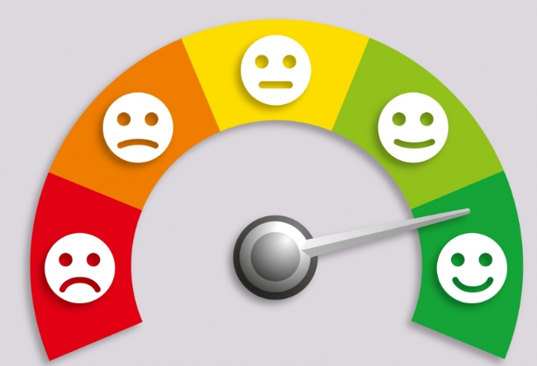

International Day of Happiness is on March 20th.

